Slide 1
Time Series Analysis
Basics of Time Series Analysis: Data Example
Nicoleta Serban, Ph.D.
Associate Professor
Stewart School of Industrial and Systems Engineering
Case Study: Emergency Department Volume

Slide 2
About this lesson

Slide 3

Emergency Department Care
Have you ever experienced long waits in the Emergency Department?
Good predictions of daily inflow in an emergency department can assist in staffing and diversion
Time series modeing can be useful in achieving good predictions.
Notes:
Body Mass Index (BMI) Score created from height and weight
Obesity: A BMI score of greater than or equal to 30
Causes incredible health problems that strain health systems and are preventable

Slide 4
Case Study Overview
Objective:
Identify temporal patterns in the Emergency Department (ED) volume of patients
Develop a model to predict ED volume
Time Series Data:
Daily number of patients visiting an emergency department of a hospital in the Atlanta area with observations from 2010 until mid 2015
Other predicting variables were made available by the hospital but we will only focus on the predictability of the time series with respect to temporal factors

Slide 5
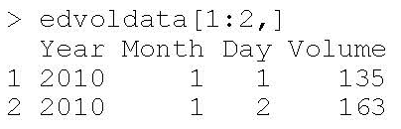
Processing Time Data
## Read data in R
edvoldata = read.csv("EGDailyVolume.csv",header=T)
## Process Dates
year = edvoldata$Year
month = edvoldata$Month
day = edvoldata$Day
datemat = cbind(as.character(day),as.character(month),as.character(year))
paste.dates = function(date){
day = date[1]; month=date[2]; year = date[3]
return(paste(day,month,year,sep="/"))
}
dates = apply(datemat,1,paste.dates)
dates = as.Date(dates, format="%d/%m/%Y")
Creating a function in R for translating three strings of characters into a date
R identifies the date strings into dates through the R command as.Date()

Slide 6
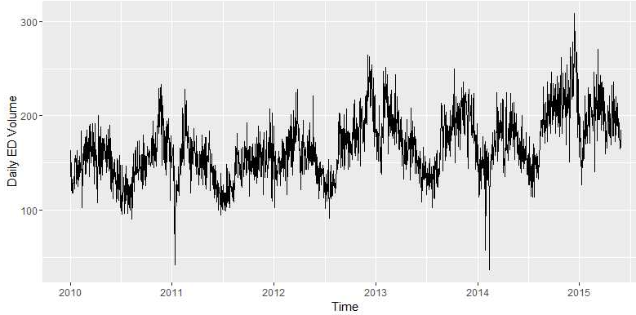
Exploratory Data Analysis
## ## Plot the time series
library(ggplot2)
ggplot(edvoldata, aes(dates, Volume)) + geom_line() + xlab("Time") + ylab("Daily ED Volume")

Slide 7
Count Data Transformation
ED Volume = Number of patients visiting ED per day ~ Poisson Distribution
Standard linear regression model assumes normality
Variance Stabilizing Transformation
## Apply Transformation
Volume.tr = sqrt(Volume+3/8)
## Compare Distribution
hist(Volume,nclass=20,xlab="ED Volume", main="",col="brown")
hist(Volume.tr,nclass=20,xlab= "Transformed ED Volume", main="",col="blue")

Slide 8
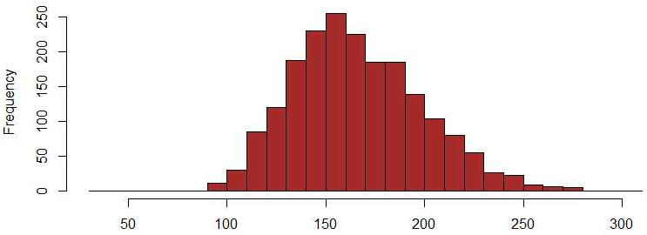
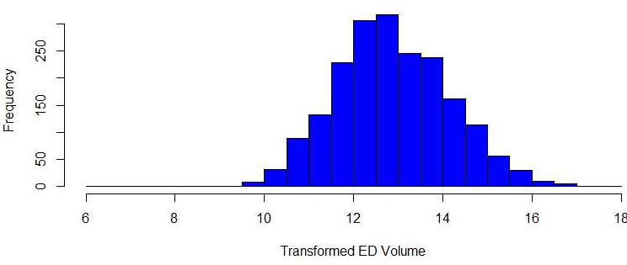
Count Data Transformation

Slide 9
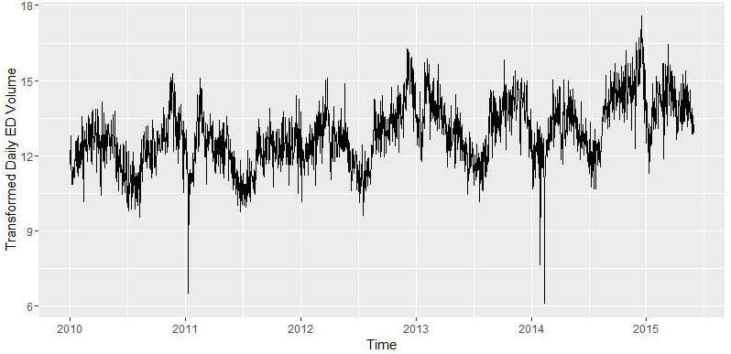
Compare: With/Without Transformation

Slide 10
Summary

